Slide 1

Particle Swarm Optimization: Workflow Demonstration
Professor Bo Liu
James Watt School of Engineering

Slide 2
PSO flow diagram
A solution in the search space A particle’s position.
Track two extreme values
A population of solutions
$$pBest$$
$$gBest$$
Replacement
New solutions
Update the speed and
position of each particle

Slide 3

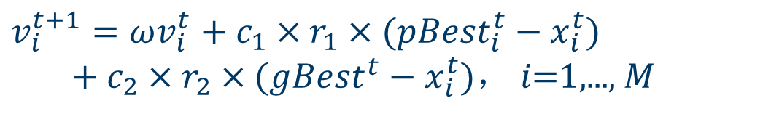
Standard PSO operators
Standard PSO algorithms:
$$v_{i}^{t+1}=ωv_{i}^{t}+c_{1}×r_{1}×(pBest_{i}^{t}−x_{i}^{t}) \\ \begin{matrix} & \end{matrix}+c_{2}×r_{2}×(gBest^{t}−x_{i}^{t})， i\text{=1,..., }M$$
$$x_{i}^{t+1}=x_{i}^{t}+v_{i}^{t+1}$$

Slide 4


Example function
An example
Test function:
where .
The particle swarm optimization algorithm is used to find the minimum value of y.
min
$$y=f(x)=x^{2}+1$$
$$−10≤x≤10$$

Slide 5

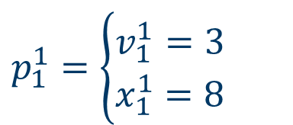
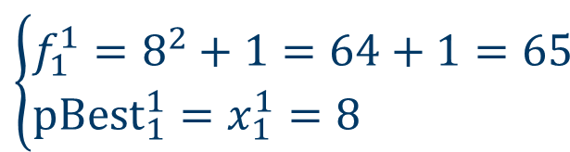

How does PSO solve an opt. problem?
Initial population t=1
$$pBest$$
$$gBest$$
Calculate ,
$$p_{1}^{1}=\left\{\begin{aligned}&v_{1}^{1}=3 \\ &x_{1}^{1}=8\end{aligned}\right.$$
$$\left\{\begin{aligned}&f_{1}^{1}=8^{2}+1=64+1=65 \\ &pBest_{1}^{1}=x_{1}^{1}=8\end{aligned}\right.$$

Slide 6


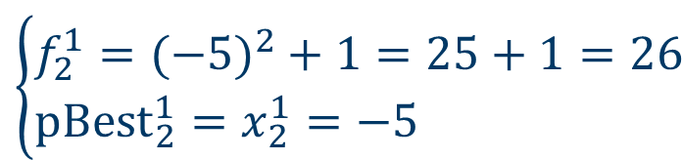
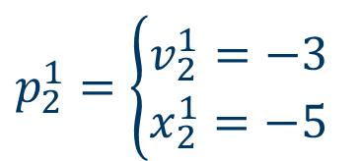
How does PSO solve an opt. problem?
Initial population t=1
$$pBest$$
$$gBest$$
Calculate ,
$$p_{2}^{1}=\left\{\begin{aligned}&v_{2}^{1}=−3 \\ &x_{2}^{1}=−5\end{aligned}\right.$$
$$\left\{\begin{aligned}&f_{2}^{1}=(−5)^{2}+1=25+1=26 \\ &pBest_{2}^{1}=x_{2}^{1}=−5\end{aligned}\right.$$

Slide 7


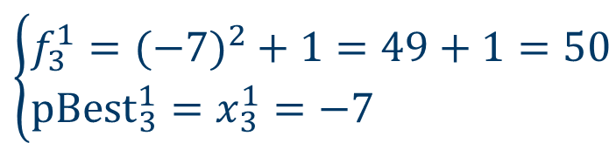
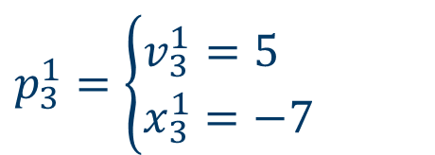
How does PSO solve an opt. problem?
Initial population t=1
$$pBest$$
$$gBest$$
Calculate ,
$$p_{3}^{1}=\left\{\begin{aligned}&v_{3}^{1}=5 \\ &x_{3}^{1}=−7\end{aligned}\right.$$
$$\left\{\begin{aligned}&f_{3}^{1}=(−7)^{2}+1=49+1=50 \\ &pBest_{3}^{1}=x_{3}^{1}=−7\end{aligned}\right.$$

Slide 8
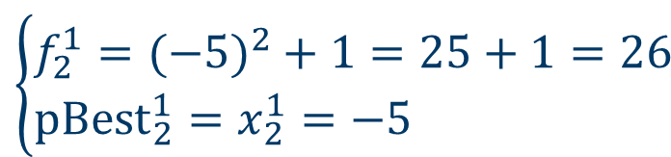

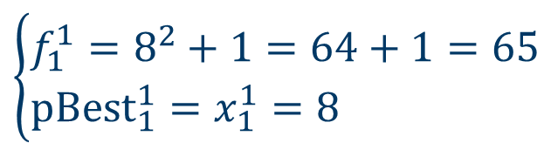

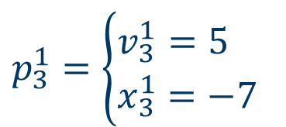
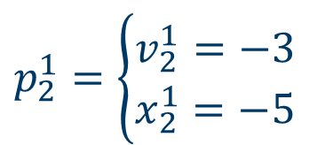

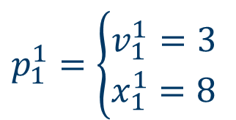
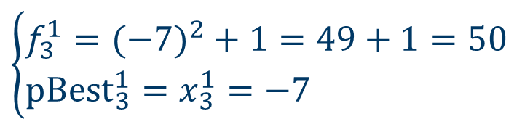
How does PSO solve an opt. problem?
$$pBest$$
$$gBest$$
Calculate ,
Initial population t=1
$$\left\{\begin{aligned}&f_{1}^{1}=8^{2}+1=64+1=65 \\ &pBest_{1}^{1}=x_{1}^{1}=8\end{aligned}\right.$$
$$p_{1}^{1}=\left\{\begin{aligned}&v_{1}^{1}=3 \\ &x_{1}^{1}=8\end{aligned}\right.$$
$$\left\{\begin{aligned}&f_{2}^{1}=(−5)^{2}+1=25+1=26 \\ &pBest_{2}^{1}=x_{2}^{1}=−5\end{aligned}\right.$$
$$p_{2}^{1}=\left\{\begin{aligned}&v_{2}^{1}=−3 \\ &x_{2}^{1}=−5\end{aligned}\right.$$
$$\left\{\begin{aligned}&f_{3}^{1}=(−7)^{2}+1=49+1=50 \\ &pBest_{3}^{1}=x_{3}^{1}=−7\end{aligned}\right.$$
$$p_{3}^{1}=\left\{\begin{aligned}&v_{3}^{1}=5 \\ &x_{3}^{1}=−7\end{aligned}\right.$$
$$gBest^{1}=pBest_{2}^{1}=−5$$
The best obj. function value in the initial population

Slide 9
PSO flow diagram
A solution in the search space A particle’s position.
Track two extreme values
A population of solutions
$$pBest$$
$$gBest$$
Replacement
New solutions
Update the speed and
position of each particle

Slide 10
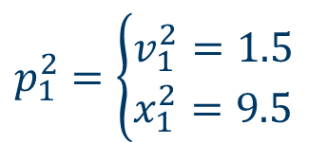
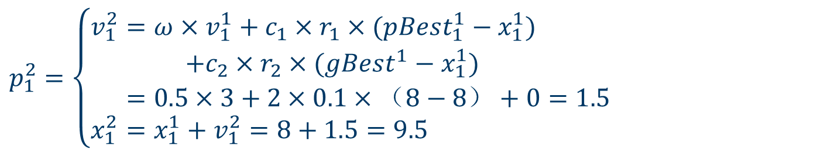
How does PSO solve an opt. problem?
Update the particle's speed and position
c₁=c₂=2, =0.5
$$p_{1}^{2}=\left\{\begin{aligned}v_{1}^{2}&=ω×v_{1}^{1}+c_{1}×r_{1}×(pBest_{1}^{1}−x_{1}^{1}) \\ +c_{2}×r_{2}×(gBest^{1}−x_{1}^{1}) \\ &=0.5×3+2×0.1×（8−8）+0=1.5 \\ x_{1}^{2}&=x_{1}^{1}+v_{1}^{2}=8+1.5=9.5\end{aligned}\right.$$
r₁=0.1, r₂=0
$$p_{1}^{2}=\left\{\begin{aligned}&v_{1}^{2}=1.5 \\ &x_{1}^{2}=9.5\end{aligned}\right.$$

Slide 11
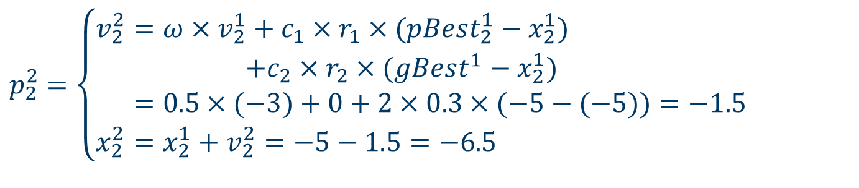
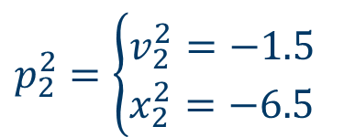
How does PSO solve an opt. problem?
Update the particle's speed and position
c₁=c₂=2, =0.5
$$p_{2}^{2}=\left\{\begin{aligned}v_{2}^{2}&=ω×v_{2}^{1}+c_{1}×r_{1}×(pBest_{2}^{1}−x_{2}^{1}) \\ +c_{2}×r_{2}×(gBest^{1}−x_{2}^{1}) \\ &=0.5×(−3)+0+2×0.3×(−5−(−5))=−1.5 \\ x_{2}^{2}&=x_{2}^{1}+v_{2}^{2}=−5−1.5=−6.5\end{aligned}\right.$$
r₁=0, r₂=0.3
$$p_{2}^{2}=\left\{\begin{aligned}&v_{2}^{2}=−1.5 \\ &x_{2}^{2}=−6.5\end{aligned}\right.$$

Slide 12
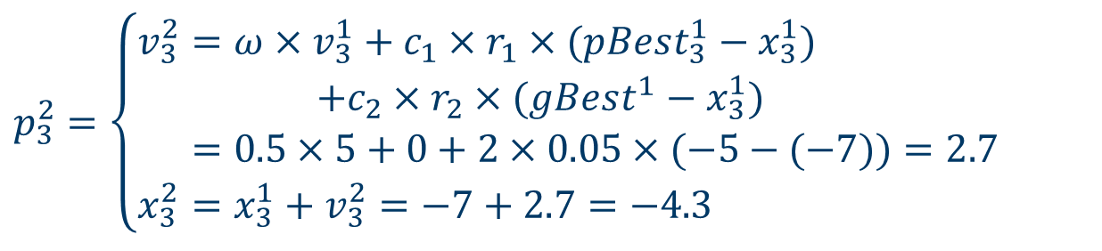
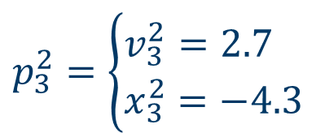
How does PSO solve an opt. problem?
Update the particle's speed and position
c₁=c₂=2, =0.5
r₁=0, r₂=0.05
$$p_{3}^{2}=\left\{\begin{aligned}v_{3}^{2}&=ω×v_{3}^{1}+c_{1}×r_{1}×(pBest_{3}^{1}−x_{3}^{1}) \\ +c_{2}×r_{2}×(gBest^{1}−x_{3}^{1}) \\ &=0.5×5+0+2×0.05×(−5−(−7))=2.7 \\ x_{3}^{2}&=x_{3}^{1}+v_{3}^{2}=−7+2.7=−4.3\end{aligned}\right.$$
$$p_{3}^{2}=\left\{\begin{aligned}&v_{3}^{2}=2.7 \\ &x_{3}^{2}=−4.3\end{aligned}\right.$$

Slide 13

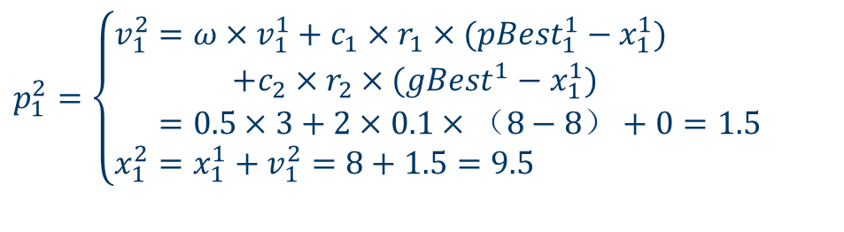


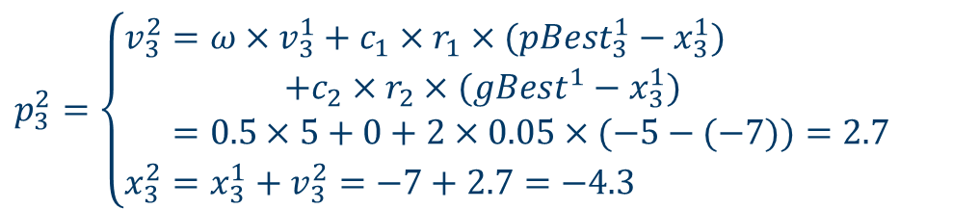
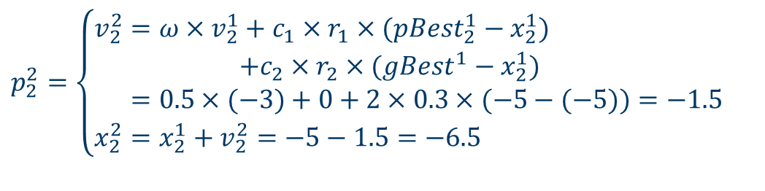
How does PSO solve an opt. problem?
Update the particle's speed and position
c₁=c₂=2, =0.5
$$p_{1}^{2}=\left\{\begin{aligned}v_{1}^{2}&=ω×v_{1}^{1}+c_{1}×r_{1}×(pBest_{1}^{1}−x_{1}^{1}) \\ +c_{2}×r_{2}×(gBest^{1}−x_{1}^{1}) \\ &=0.5×3+2×0.1×（8−8）+0=1.5 \\ x_{1}^{2}&=x_{1}^{1}+v_{1}^{2}=8+1.5=9.5\end{aligned}\right.$$
r₁=0.1, r₂=0
$$p_{1}^{2}=\left\{\begin{aligned}&v_{1}^{2}=1.5 \\ &x_{1}^{2}=9.5\end{aligned}\right.$$
$$p_{2}^{2}=\left\{\begin{aligned}v_{2}^{2}&=ω×v_{2}^{1}+c_{1}×r_{1}×(pBest_{2}^{1}−x_{2}^{1}) \\ +c_{2}×r_{2}×(gBest^{1}−x_{2}^{1}) \\ &=0.5×(−3)+0+2×0.3×(−5−(−5))=−1.5 \\ x_{2}^{2}&=x_{2}^{1}+v_{2}^{2}=−5−1.5=−6.5\end{aligned}\right.$$
$$p_{2}^{2}=\left\{\begin{aligned}&v_{2}^{2}=−1.5 \\ &x_{2}^{2}=−6.5\end{aligned}\right.$$
r₁=0, r₂=0.3
$$p_{3}^{2}=\left\{\begin{aligned}&v_{3}^{2}=2.7 \\ &x_{3}^{2}=−4.3\end{aligned}\right.$$
$$p_{3}^{2}=\left\{\begin{aligned}v_{3}^{2}&=ω×v_{3}^{1}+c_{1}×r_{1}×(pBest_{3}^{1}−x_{3}^{1}) \\ +c_{2}×r_{2}×(gBest^{1}−x_{3}^{1}) \\ &=0.5×5+0+2×0.05×(−5−(−7))=2.7 \\ x_{3}^{2}&=x_{3}^{1}+v_{3}^{2}=−7+2.7=−4.3\end{aligned}\right.$$
The population of the second iteration
r₁=0, r₂=0.05

Slide 14
PSO flow diagram
A solution in the search space A particle’s position.
Track two extreme values
A population of solutions
$$pBest$$
$$gBest$$
Replacement
New solutions
Update the speed and
position of each particle

Slide 15




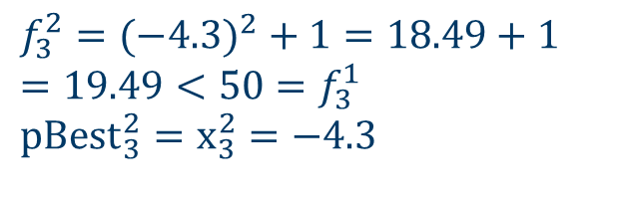



How does PSO solve an opt. problem?
The population of the second iteration
Update ,
$$pbest$$
$$gbest$$
$$f_{1}^{2}=9.5^{2}+1=90.25+1 \\ =91.25>f_{1}^{1}=65 \\ pBest_{1}^{2}=x_{1}^{1}=8$$
$$p_{1}^{2}=\left\{\begin{aligned}&v_{1}^{2}=1.5 \\ &x_{1}^{2}=9.5\end{aligned}\right.$$
$$p_{2}^{2}=\left\{\begin{aligned}&v_{2}^{2}=−1.5 \\ &x_{2}^{2}=−6.5\end{aligned}\right.$$
$$f_{2}^{2}={\left(−6.5\right)}^{2}+1=42.25+1 \\ =43.25>26=f_{2}^{1} \\ pBest_{2}^{2}=x_{2}^{1}=−5$$
$$p_{3}^{2}=\left\{\begin{aligned}&v_{3}^{2}=2.7 \\ &x_{3}^{2}=−4.3\end{aligned}\right.$$
$$f_{3}^{2}=(−4.3)^{2}+1=18.49+1 \\ =19.49<50=f_{3}^{1} \\ pBest_{3}^{2}=x_{3}^{2}=−4.3$$

Slide 16
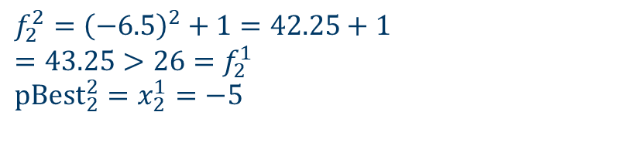




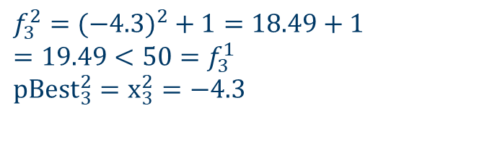
How does PSO solve an opt. problem?
The population of the second iteration
Update ,
$$pbest$$
$$gbest$$
$$f_{1}^{2}=9.5^{2}+1=90.25+1 \\ =91.25>f_{1}^{1}=65 \\ pBest_{1}^{2}=x_{1}^{1}=8$$
$$p_{1}^{2}=\left\{\begin{aligned}&v_{1}^{2}=1.5 \\ &x_{1}^{2}=9.5\end{aligned}\right.$$
$$p_{2}^{2}=\left\{\begin{aligned}&v_{2}^{2}=−1.5 \\ &x_{2}^{2}=−6.5\end{aligned}\right.$$
$$f_{2}^{2}={\left(−6.5\right)}^{2}+1=42.25+1 \\ =43.25>26=f_{2}^{1} \\ pBest_{2}^{2}=x_{2}^{1}=−5$$
$$p_{3}^{2}=\left\{\begin{aligned}&v_{3}^{2}=2.7 \\ &x_{3}^{2}=−4.3\end{aligned}\right.$$
$$f_{3}^{2}=(−4.3)^{2}+1=18.49+1 \\ =19.49<50=f_{3}^{1} \\ pBest_{3}^{2}=x_{3}^{2}=−4.3$$

Slide 17








How does PSO solve an opt. problem?
Update ,
$$gbest$$
The population of the second iteration
$$pbest$$
$$f_{1}^{2}=9.5^{2}+1=90.25+1 \\ =91.25>f_{1}^{1}=65 \\ pBest_{1}^{2}=x_{1}^{1}=8$$
$$p_{1}^{2}=\left\{\begin{aligned}&v_{1}^{2}=1.5 \\ &x_{1}^{2}=9.5\end{aligned}\right.$$
$$f_{2}^{2}={\left(−6.5\right)}^{2}+1=42.25+1 \\ =43.25>26=f_{2}^{1} \\ pBest_{2}^{2}=x_{2}^{1}=−5$$
$$p_{2}^{2}=\left\{\begin{aligned}&v_{2}^{2}=−1.5 \\ &x_{2}^{2}=−6.5\end{aligned}\right.$$
$$p_{3}^{2}=\left\{\begin{aligned}&v_{3}^{2}=2.7 \\ &x_{3}^{2}=−4.3\end{aligned}\right.$$
$$f_{3}^{2}=(−4.3)^{2}+1=18.49+1 \\ =19.49<50=f_{3}^{1} \\ pBest_{3}^{2}=x_{3}^{2}=−4.3$$

Slide 18




How does PSO solve an opt. problem?
The population of the second iteration
Update ,
$$gbest$$
$$pbest$$
$$f_{1}^{2}=9.5^{2}+1=90.25+1 \\ =91.25>f_{1}^{1}=65 \\ pBest_{1}^{2}=x_{1}^{1}=8$$
$$p_{1}^{2}=\left\{\begin{aligned}&v_{1}^{2}=1.5 \\ &x_{1}^{2}=9.5\end{aligned}\right.$$
$$f_{2}^{2}={\left(−6.5\right)}^{2}+1=42.25+1 \\ =43.25>26=f_{2}^{1} \\ pBest_{2}^{2}=x_{2}^{1}=−5$$
$$p_{2}^{2}=\left\{\begin{aligned}&v_{2}^{2}=−1.5 \\ &x_{2}^{2}=−6.5\end{aligned}\right.$$
The best fitness value in the population of the second iteration
$$p_{3}^{2}=\left\{\begin{aligned}&v_{3}^{2}=2.7 \\ &x_{3}^{2}=−4.3\end{aligned}\right.$$
$$f_{3}^{2}=(−4.3)^{2}+1=18.49+1 \\ =19.49<50=f_{3}^{1} \\ pBest_{3}^{2}=x_{3}^{2}=−4.3$$
$$gBest^{2}=pBest_{3}^{2}=−4.3$$

Slide 19
PSO flow diagram
A solution in the search space A particle’s position.
Track two extreme values
A population of solutions
$$pBest$$
$$gBest$$
Replacement
New solutions
Update the speed and
position of each particle

Slide 20

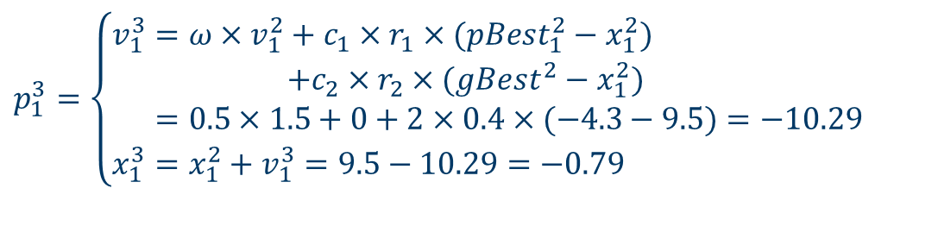


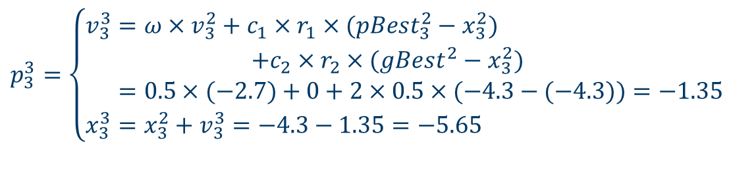
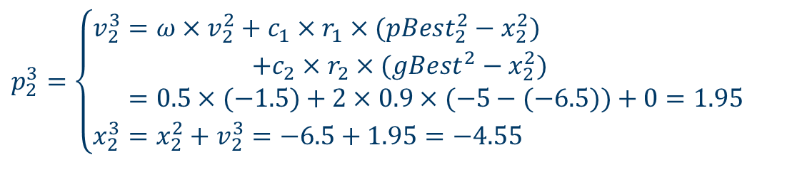
How does PSO solve an opt. problem?
Update the particle's speed and position
c₁=c₂=2, =0.5
$$p_{1}^{3}=\left\{\begin{aligned}v_{1}^{3}&=ω×v_{1}^{2}+c_{1}×r_{1}×(pBest_{1}^{2}−x_{1}^{2}) \\ +c_{2}×r_{2}×(gBest^{2}−x_{1}^{2}) \\ &=0.5×1.5+0+2×0.4×(−4.3−9.5)=−10.29 \\ x_{1}^{3}&=x_{1}^{2}+v_{1}^{3}=9.5−10.29=−\text{0.79}\end{aligned}\right.$$
r₁=0, r₂=0.4
$$p_{1}^{3}=\left\{\begin{aligned}&v_{1}^{3}=−10.29 \\ &x_{1}^{3}=−0.79\end{aligned}\right.$$
$$p_{2}^{3}=\left\{\begin{aligned}&v_{2}^{3}=1.95 \\ &x_{2}^{3}=−4.55\end{aligned}\right.$$
$$p_{2}^{3}=\left\{\begin{aligned}v_{2}^{3}&=ω×v_{2}^{2}+c_{1}×r_{1}×(pBest_{2}^{2}−x_{2}^{2}) \\ +c_{2}×r_{2}×(gBest^{2}−x_{2}^{2}) \\ &=0.5×(−1.5)+2×0.9×(−5−(−6.5))+0=1.95 \\ x_{2}^{3}&=x_{2}^{2}+v_{2}^{3}=−6.5+1.95=−4.55\end{aligned}\right.$$
r₁=0.9, r₂=0
$$p_{3}^{3}=\left\{\begin{aligned}&v_{3}^{3}=−1.35 \\ &x_{3}^{3}=−5.65\end{aligned}\right.$$
$$p_{3}^{3}=\left\{\begin{aligned}v_{3}^{3}&=ω×v_{3}^{2}+c_{1}×r_{1}×(pBest_{3}^{2}−x_{3}^{2}) \\ +c_{2}×r_{2}×(gBest^{2}−x_{3}^{2}) \\ &=0.5×(−2.7)+0+2×0.5×(−4.3−(−4.3))=−1.35 \\ x_{3}^{3}&=x_{3}^{2}+v_{3}^{3}=−4.3−1.35=−\text{5.65}\end{aligned}\right.$$
The population of the third iteration
r₁=0, r₂=0.5

Slide 21
How does PSO solve an opt. problem?
Update the particle's speed and position
c₁=c₂=2, =0.5
$$p_{1}^{3}=\left\{\begin{aligned}v_{1}^{3}&=ω×v_{1}^{2}+c_{1}×r_{1}×(pBest_{1}^{2}−x_{1}^{2}) \\ +c_{2}×r_{2}×(gBest^{2}−x_{1}^{2}) \\ &=0.5×1.5+0+2×0.4×(−4.3−9.5)=−10.29 \\ x_{1}^{3}&=x_{1}^{2}+v_{1}^{3}=9.5−10.29=−\text{0.79}\end{aligned}\right.$$
r₁=0, r₂=0.4
$$p_{1}^{3}=\left\{\begin{aligned}&v_{1}^{3}=−10.29 \\ &x_{1}^{3}=−0.79\end{aligned}\right.$$
$$p_{2}^{3}=\left\{\begin{aligned}&v_{2}^{3}=1.95 \\ &x_{2}^{3}=−4.55\end{aligned}\right.$$
$$p_{2}^{3}=\left\{\begin{aligned}v_{2}^{3}&=ω×v_{2}^{2}+c_{1}×r_{1}×(pBest_{2}^{2}−x_{2}^{2}) \\ +c_{2}×r_{2}×(gBest^{2}−x_{2}^{2}) \\ &=0.5×(−1.5)+2×0.9×(−5−(−6.5))+0=1.95 \\ x_{2}^{3}&=x_{2}^{2}+v_{2}^{3}=−6.5+1.95=−4.55\end{aligned}\right.$$
r₁=0.9, r₂=0
$$p_{3}^{3}=\left\{\begin{aligned}&v_{3}^{3}=−1.35 \\ &x_{3}^{3}=−5.65\end{aligned}\right.$$
$$p_{3}^{3}=\left\{\begin{aligned}v_{3}^{3}&=ω×v_{3}^{2}+c_{1}×r_{1}×(pBest_{3}^{2}−x_{3}^{2}) \\ +c_{2}×r_{2}×(gBest^{2}−x_{3}^{2}) \\ &=0.5×(−2.7)+0+2×0.5×(−4.3−(−4.3))=−1.35 \\ x_{3}^{3}&=x_{3}^{2}+v_{3}^{3}=−4.3−1.35=−\text{5.65}\end{aligned}\right.$$
The population of the third iteration
r₁=0, r₂=0.5

Slide 22
How does PSO solve an opt. problem?
Update the particle's speed and position
c₁=c₂=2, =0.5
$$p_{1}^{3}=\left\{\begin{aligned}v_{1}^{3}&=ω×v_{1}^{2}+c_{1}×r_{1}×(pBest_{1}^{2}−x_{1}^{2}) \\ +c_{2}×r_{2}×(gBest^{2}−x_{1}^{2}) \\ &=0.5×1.5+0+2×0.4×(−4.3−9.5)=−10.29 \\ x_{1}^{3}&=x_{1}^{2}+v_{1}^{3}=9.5−10.29=−\text{0.79}\end{aligned}\right.$$
r₁=0, r₂=0.4
$$p_{1}^{3}=\left\{\begin{aligned}&v_{1}^{3}=−10.29 \\ &x_{1}^{3}=−0.79\end{aligned}\right.$$
$$p_{2}^{3}=\left\{\begin{aligned}&v_{2}^{3}=1.95 \\ &x_{2}^{3}=−4.55\end{aligned}\right.$$
$$p_{2}^{3}=\left\{\begin{aligned}v_{2}^{3}&=ω×v_{2}^{2}+c_{1}×r_{1}×(pBest_{2}^{2}−x_{2}^{2}) \\ +c_{2}×r_{2}×(gBest^{2}−x_{2}^{2}) \\ &=0.5×(−1.5)+2×0.9×(−5−(−6.5))+0=1.95 \\ x_{2}^{3}&=x_{2}^{2}+v_{2}^{3}=−6.5+1.95=−4.55\end{aligned}\right.$$
r₁=0.9, r₂=0
$$p_{3}^{3}=\left\{\begin{aligned}&v_{3}^{3}=−1.35 \\ &x_{3}^{3}=−5.65\end{aligned}\right.$$
$$p_{3}^{3}=\left\{\begin{aligned}v_{3}^{3}&=ω×v_{3}^{2}+c_{1}×r_{1}×(pBest_{3}^{2}−x_{3}^{2}) \\ +c_{2}×r_{2}×(gBest^{2}−x_{3}^{2}) \\ &=0.5×(−2.7)+0+2×0.5×(−4.3−(−4.3))=−1.35 \\ x_{3}^{3}&=x_{3}^{2}+v_{3}^{3}=−4.3−1.35=−\text{5.65}\end{aligned}\right.$$
The population of the third iteration
r₁=0, r₂=0.5

Slide 23
How does PSO solve an opt. problem?
Update the particle's speed and position
c₁=c₂=2, =0.5
$$p_{1}^{3}=\left\{\begin{aligned}v_{1}^{3}&=ω×v_{1}^{2}+c_{1}×r_{1}×(pBest_{1}^{2}−x_{1}^{2}) \\ +c_{2}×r_{2}×(gBest^{2}−x_{1}^{2}) \\ &=0.5×1.5+0+2×0.4×(−4.3−9.5)=−10.29 \\ x_{1}^{3}&=x_{1}^{2}+v_{1}^{3}=9.5−10.29=−\text{0.79}\end{aligned}\right.$$
r₁=0, r₂=0.4
$$p_{1}^{3}=\left\{\begin{aligned}&v_{1}^{3}=−10.29 \\ &x_{1}^{3}=−0.79\end{aligned}\right.$$
$$p_{2}^{3}=\left\{\begin{aligned}&v_{2}^{3}=1.95 \\ &x_{2}^{3}=−4.55\end{aligned}\right.$$
$$p_{2}^{3}=\left\{\begin{aligned}v_{2}^{3}&=ω×v_{2}^{2}+c_{1}×r_{1}×(pBest_{2}^{2}−x_{2}^{2}) \\ +c_{2}×r_{2}×(gBest^{2}−x_{2}^{2}) \\ &=0.5×(−1.5)+2×0.9×(−5−(−6.5))+0=1.95 \\ x_{2}^{3}&=x_{2}^{2}+v_{2}^{3}=−6.5+1.95=−4.55\end{aligned}\right.$$
r₁=0.9, r₂=0
$$p_{3}^{3}=\left\{\begin{aligned}&v_{3}^{3}=−1.35 \\ &x_{3}^{3}=−5.65\end{aligned}\right.$$
$$p_{3}^{3}=\left\{\begin{aligned}v_{3}^{3}&=ω×v_{3}^{2}+c_{1}×r_{1}×(pBest_{3}^{2}−x_{3}^{2}) \\ +c_{2}×r_{2}×(gBest^{2}−x_{3}^{2}) \\ &=0.5×(−2.7)+0+2×0.5×(−4.3−(−4.3))=−1.35 \\ x_{3}^{3}&=x_{3}^{2}+v_{3}^{3}=−4.3−1.35=−\text{5.65}\end{aligned}\right.$$
The population of the third iteration
r₁=0, r₂=0.5

Slide 24






How does PSO solve an opt. problem?
The population of the third iteration
Update ,
$$gbest$$
$$pbest$$
$$f_{1}^{2}={\left(−0.79\right)}^{2}+1=0.62+1 \\ =1.62<f_{1}^{1}=65 \\ pBest_{1}^{3}=x_{1}^{3}=−0.79$$
$$p_{1}^{3}=\left\{\begin{aligned}&v_{1}^{3}=−10.29 \\ &x_{1}^{3}=−0.79\end{aligned}\right.$$
$$f_{2}^{2}={\left(−4.55\right)}^{2}+1=20.70+1 \\ =21.70<26=f_{2}^{2} \\ pBest_{2}^{3}=x_{2}^{3}=−4.55$$
$$p_{2}^{3}=\left\{\begin{aligned}&v_{2}^{3}=1.95 \\ &x_{2}^{3}=−4.55\end{aligned}\right.$$
$$p_{3}^{3}=\left\{\begin{aligned}&v_{3}^{3}=−1.35 \\ &x_{3}^{3}=−5.65\end{aligned}\right.$$
$$f_{3}^{3}=(−5.65)^{2}+1=31.92+1 \\ =32.92>17.49=f_{3}^{2} \\ pBest_{3}^{3}=x_{3}^{2}=−4.3$$

Slide 25


How does PSO solve an opt. problem?
The population of the third iteration
Update ,
$$gbest$$
$$pbest$$
$$f_{1}^{2}={\left(−0.79\right)}^{2}+1=0.62+1 \\ =1.62<f_{1}^{1}=65 \\ pBest_{1}^{3}=x_{1}^{3}=−0.79$$
$$p_{1}^{3}=\left\{\begin{aligned}&v_{1}^{3}=−10.29 \\ &x_{1}^{3}=−0.79\end{aligned}\right.$$
$$f_{2}^{2}={\left(−4.55\right)}^{2}+1=20.70+1 \\ =21.70<26=f_{2}^{2} \\ pBest_{2}^{3}=x_{2}^{3}=−4.55$$
$$p_{2}^{3}=\left\{\begin{aligned}&v_{2}^{3}=1.95 \\ &x_{2}^{3}=−4.55\end{aligned}\right.$$
$$p_{3}^{3}=\left\{\begin{aligned}&v_{3}^{3}=−1.35 \\ &x_{3}^{3}=−5.65\end{aligned}\right.$$
$$f_{3}^{3}=(−5.65)^{2}+1=31.92+1 \\ =32.92>17.49=f_{3}^{2} \\ pBest_{3}^{3}=x_{3}^{2}=−4.3$$

Slide 26

How does PSO solve an opt. problem?
The population of the third iteration
Update ,
$$gbest$$
$$pbest$$
$$f_{1}^{2}={\left(−0.79\right)}^{2}+1=0.62+1 \\ =1.62<f_{1}^{1}=65 \\ pBest_{1}^{3}=x_{1}^{3}=−0.79$$
$$p_{1}^{3}=\left\{\begin{aligned}&v_{1}^{3}=−10.29 \\ &x_{1}^{3}=−0.79\end{aligned}\right.$$
$$f_{2}^{2}={\left(−4.55\right)}^{2}+1=20.70+1 \\ =21.70<26=f_{2}^{2} \\ pBest_{2}^{3}=x_{2}^{3}=−4.55$$
$$p_{2}^{3}=\left\{\begin{aligned}&v_{2}^{3}=1.95 \\ &x_{2}^{3}=−4.55\end{aligned}\right.$$
$$p_{3}^{3}=\left\{\begin{aligned}&v_{3}^{3}=−1.35 \\ &x_{3}^{3}=−5.65\end{aligned}\right.$$
$$f_{3}^{3}=(−5.65)^{2}+1=31.92+1 \\ =32.92>17.49=f_{3}^{2} \\ pBest_{3}^{3}=x_{3}^{2}=−4.3$$

Slide 27

How does PSO solve an opt. problem?
The population of the third iteration
Update ,
$$gbest$$
$$pbest$$
$$f_{1}^{2}={\left(−0.79\right)}^{2}+1=0.62+1 \\ =1.62<f_{1}^{1}=65 \\ pBest_{1}^{3}=x_{1}^{3}=−0.79$$
$$p_{1}^{3}=\left\{\begin{aligned}&v_{1}^{3}=−10.29 \\ &x_{1}^{3}=−0.79\end{aligned}\right.$$
The best fitness value in the population of the third iteration
$$f_{2}^{2}={\left(−4.55\right)}^{2}+1=20.70+1 \\ =21.70<26=f_{2}^{2} \\ pBest_{2}^{3}=x_{2}^{3}=−4.55$$
$$p_{2}^{3}=\left\{\begin{aligned}&v_{2}^{3}=1.95 \\ &x_{2}^{3}=−4.55\end{aligned}\right.$$
$$p_{3}^{3}=\left\{\begin{aligned}&v_{3}^{3}=−1.35 \\ &x_{3}^{3}=−5.65\end{aligned}\right.$$
$$f_{3}^{3}=(−5.65)^{2}+1=31.92+1 \\ =32.92>17.49=f_{3}^{2} \\ pBest_{3}^{3}=x_{3}^{2}=−4.3$$
$$gBest^{3}=pBest_{1}^{3}=−0.79$$

Slide 28
How does PSO solve an opt. problem?
Iteration | The first iteration |  |  | The second iteration |  |  | The third iteration
Particles | P₁ | P₂ | P₃ | P₁ | P₂ | P₃ | P₁ | P₂ | P₃
Solutions | 8 | -5 | -7 | 9.5 | -6.5 | -4.3 | -0.79 | -4.55 | -5.65
pBest | 8 | -5 | -7 | 8 | -5 | -4.3 | -0.79 | -4.55 | -4.3
gBest | -5 |  |  | -4.3 |  |  | -0.79
Objective function value | 65 | 26 | 50 | 91.25 | 43.25 | 19.49 | 1.62 | 21.70 | 32.92

Slide 29
How does PSO solve an opt. problem?
If the termination conditions do not meet, continue the iterations;
Otherwise, output gBest and end the program.

Slide 30




Thanks!
#UofGWorldChangers
@UofGlasgow

